Slide 1

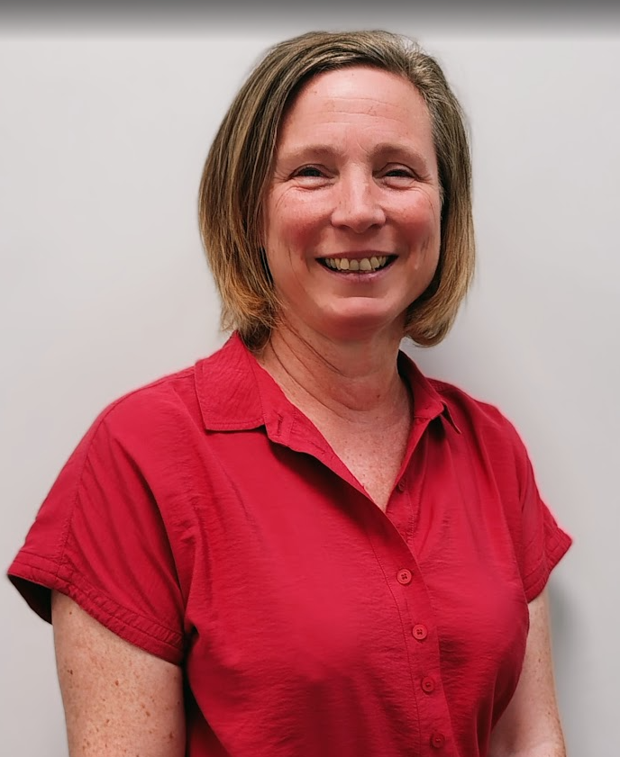
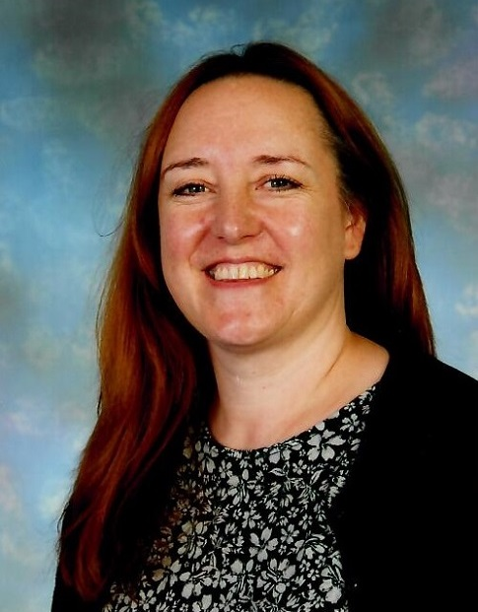
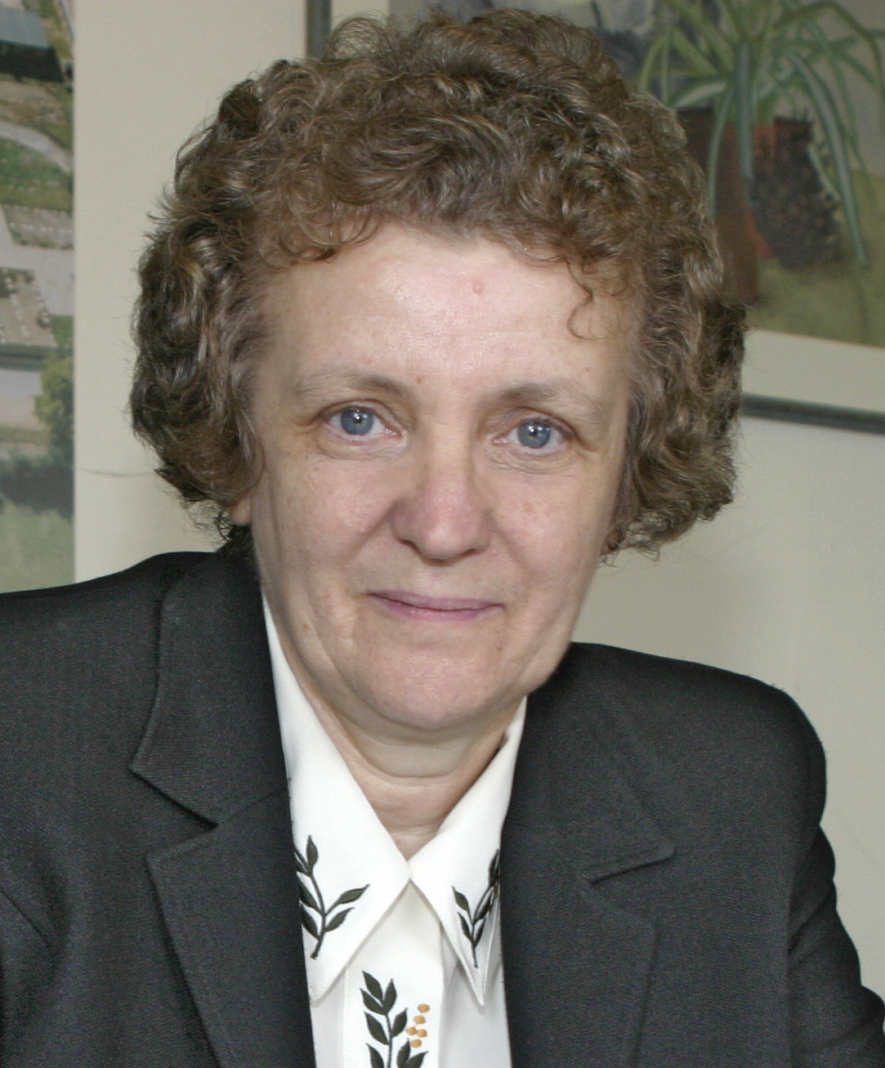
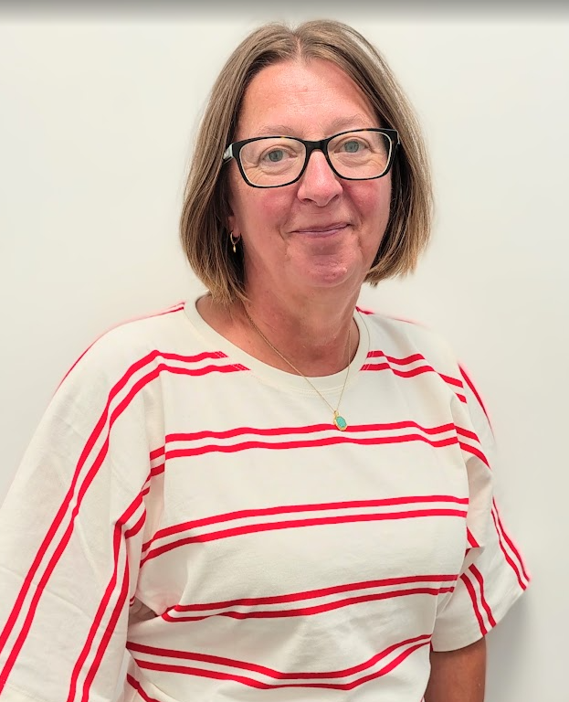
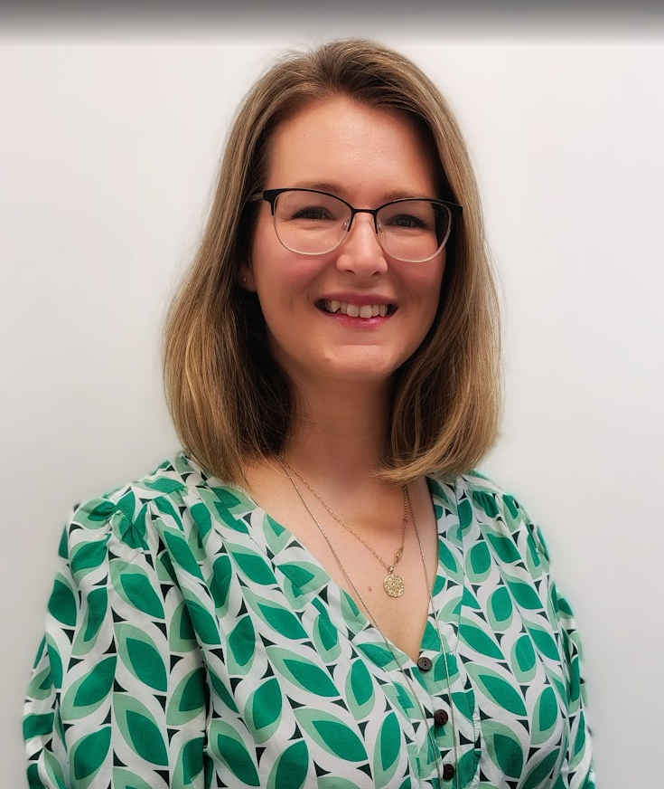
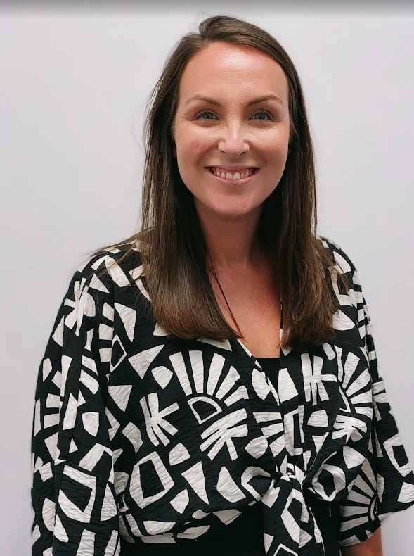
Are you concerned about a pupil?
If you are worried about a pupil
Record your concerns on CPOMS
You must share your concerns without delay
Cynthia Bartlett
Safeguarding Governor
Contact via the Office
Rachael Long
Safeguarding Gatekeeper
Designated Safeguarding Lead Team
Kate Downes
Katie Sharp
Maria Penn
Lisa Upcott
FESO
In the event of an incident occurring outside of school hours
If you believe that a child is in immediate danger or at risk of harm,
a referral should be made to the
MASH (0345 050 7666) and/or the
Police (101/999) immediately
In the event of a concern around a professional or a volunteer
If you believe that an adult who works with children is causing concern, and you are unable to contact a school DSL, a referral should be made to the
LADO (01865 810603) or email lado.safeguardingchildren@oxfordshire.gov.uk

